Slide 1
OPINIONATED BY NECESSITY
Lessons from Building Apps for Real Clients

Slide 2




HELLO
WELCOME
Matt Goldman
Apps and Innovation Consultant
Co-host, Beer Driven Devs Podcast
.NET MAUI in Action
Notes:
Sorry, I’m needed in surgery

Slide 3
SCALE
BUILDING APPS
THAT SCALE

Slide 4
SCALE
“Systems that
continue to work
when the people
who built them
are no longer in
the room.”

Slide 5

THE MYCONTOSO PROJECT
A Story in Three Sprints
ABOUT

Slide 6
Inspired by true events
Names, places, events, and other things have been changed to protect the guilty
(me)

Slide 7
THE BRIEF
ABOUT

Slide 8
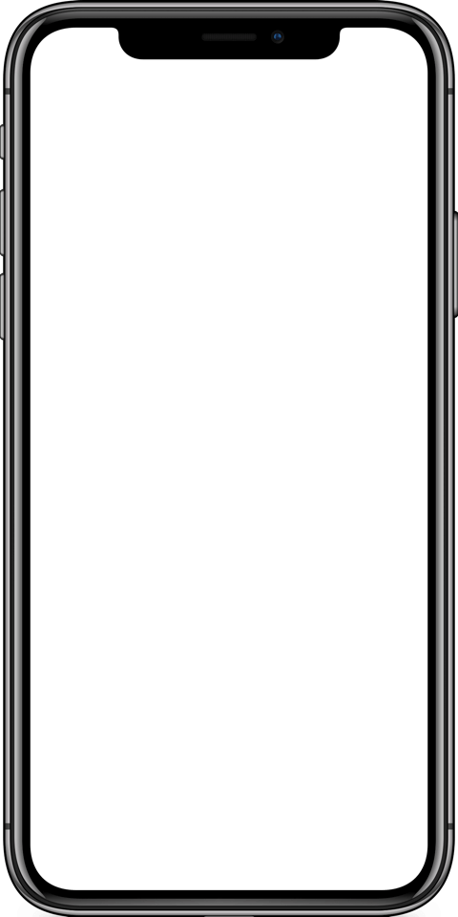
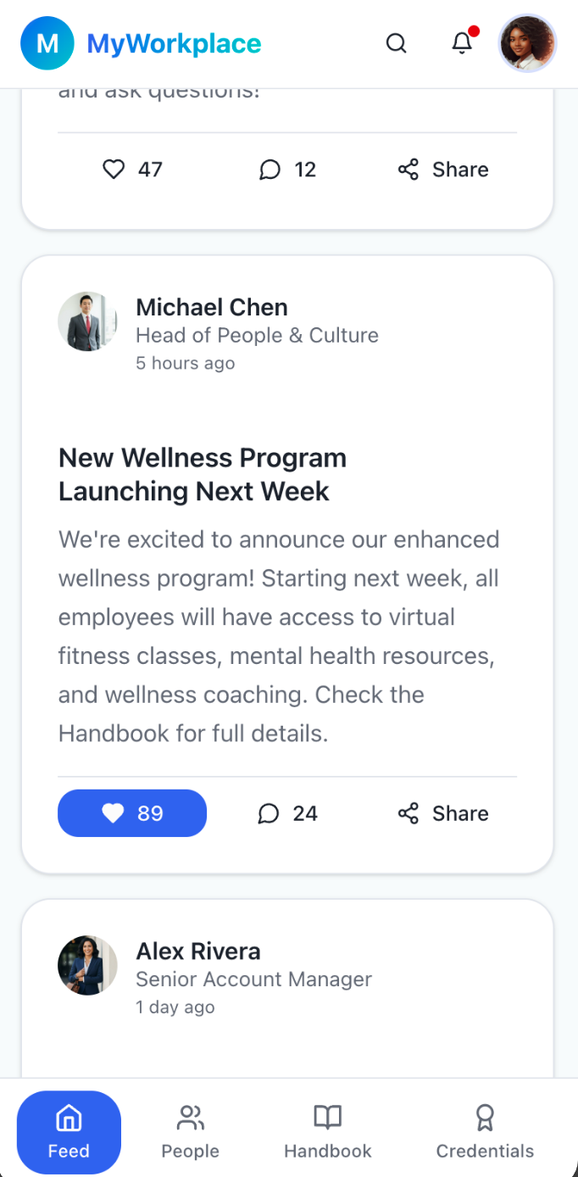
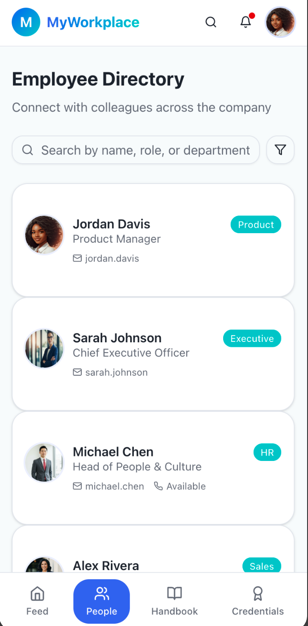
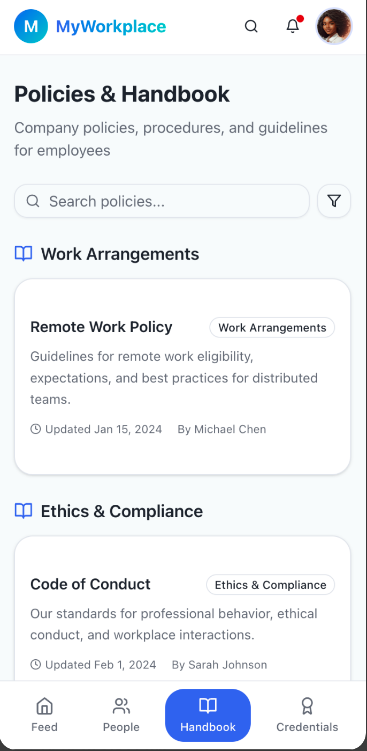
FLAGSHIP FEATURES
MyContoso

Slide 9
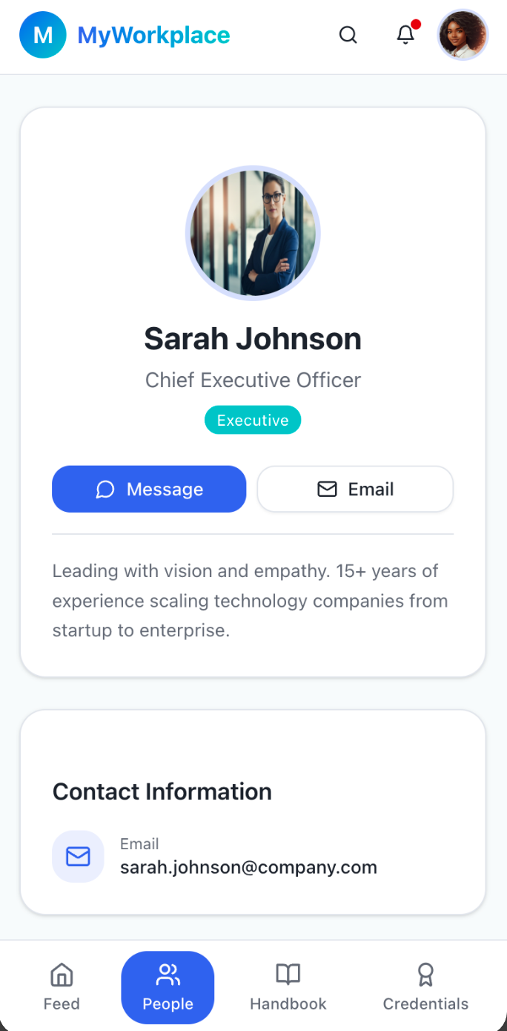
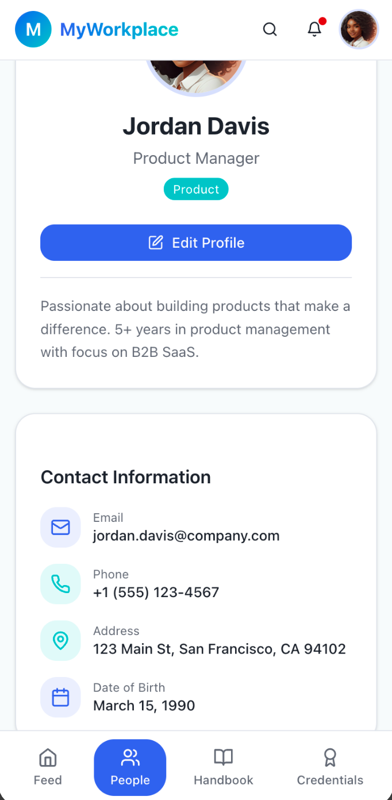
USER PROFILES
MYContoso
VIEW OTHER EMPLOYEES
MANAGE YOUR PROFILE

Slide 10
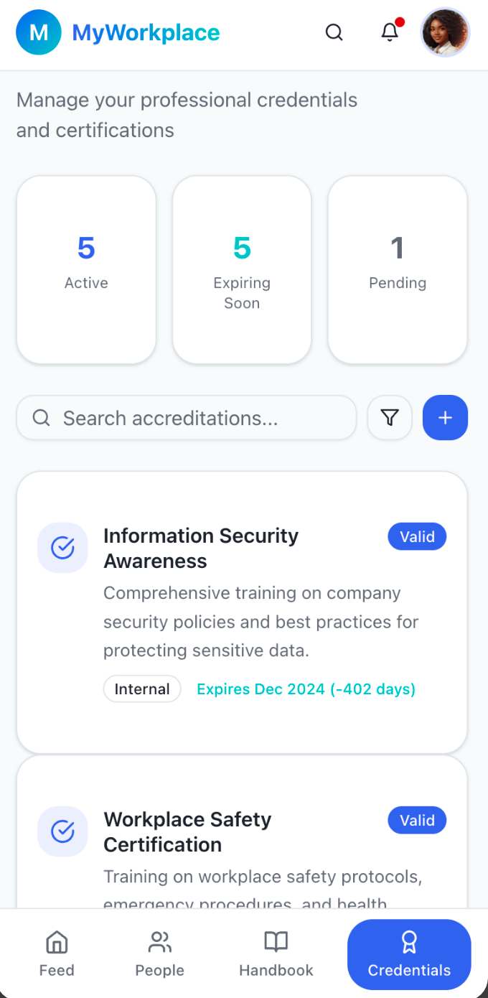
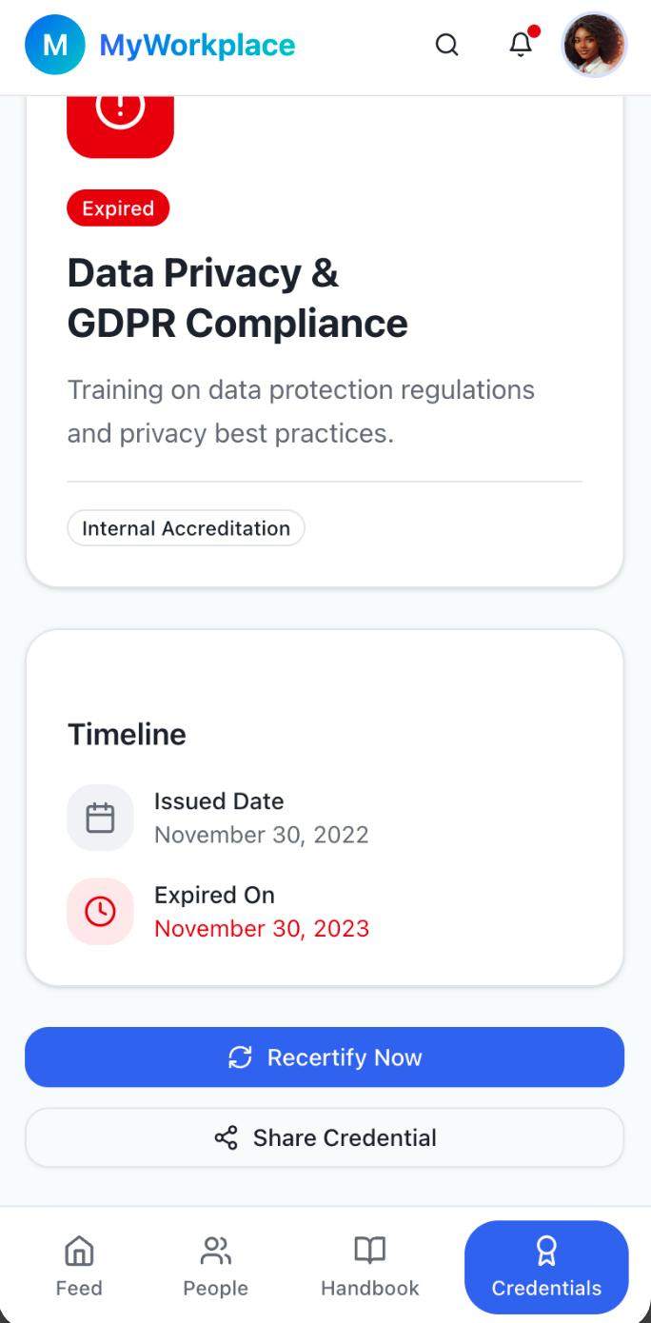
ACCREDITATIONS
DEVICS
VIEW YOUR ACCREDITATIONS
MANAGE EXPIRED OR EXPIRING ACCREDITATIONS

Slide 11
ARCHITECTURE
Architecture

Slide 12
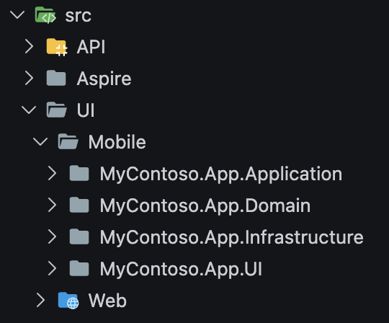

Slide 13
Presentation
Application
Domain
Infrastructure

Slide 14
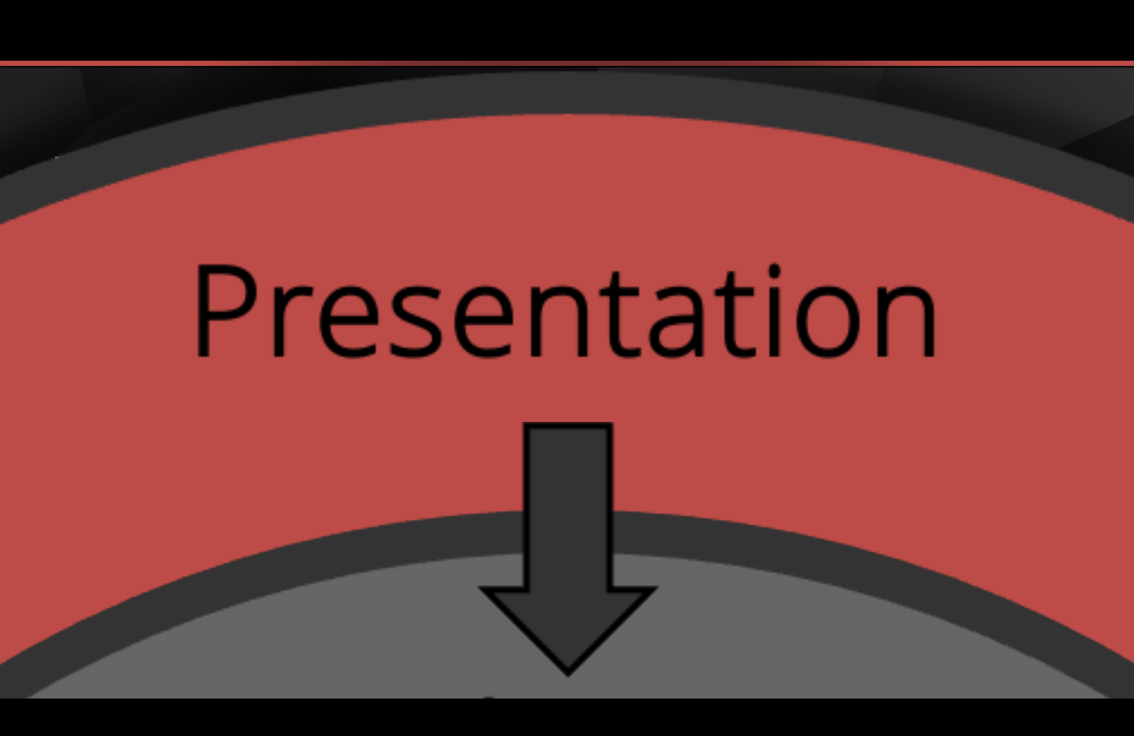
Presentation
Application
Domain
Infrastructure

Slide 15
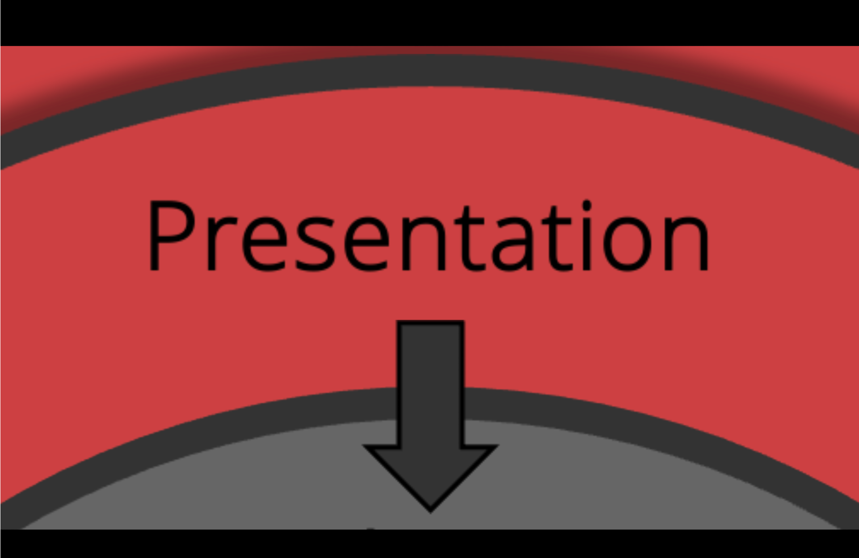
Presentation
Application
Domain
Infrastructure

Slide 16
MVVM Architecture?

Slide 17
MVVM Pattern.

Slide 18
Sprint 1
1
SPRINT

Slide 19
SPRINT 1 OBSERVATIONS
SERVICE
1.
2.
3.
MESSAGING
Code smell in general
Publisher in View
MOCK API CLIENT
Great use of MVVM
NAVIGATION
Magic strings
Not treated as a system
4.
5.
6.
DI LIFETIMES
Singleton by default
UI PROPERTIES
Defined in ViewModels
UI BUG
Edit other users’ profiles
Major security issue

Slide 20
2
Sprint 2
SPRINT

Slide 21
SPRINT 2 OBSERVATIONS
SERVICE
1.
2.
3.
API MODELS
Uses adapters
Where is the source of truth?
SERVICES
Great use of MVVM
HORIZONTAL DEPENDENCIES
Magic strings
Not treated as a system
4.
5.
BUG NOT FIXED
Singleton by default
UI PROPERTIES
Moved to Models (worse!)

Slide 22
3
Sprint 3
SPRINT

Slide 23
SPRINT 3 OBSERVATIONS
SERVICE
1.
2.
3.
MODULES
Implicit structure
Defines boundaries
Doesn’t (currently) enforce them)
NAVIGATION
Improved (in modules now)
Still not a system
MESSAGING
Fixed!
Explicit publishers
Publishers and subscribers in the right layer
4.
5.
6.
BUG FIXED!
DI lifetimes treated as a correctness question, not a performance question
UI PROPERTIES
UI properties in UI
State in ViewModel
Converters doing their job
CONTROLS
Defensible
Not required for reuse
More maintainable
Notes:
NAVIGATION – mention book

Slide 24
TAKEAWAYS
KEY
TAKEAWAYS

Slide 25


TREAT MESSAGING AS A CODE SMELL
MESSAGING
DON’T use messaging for routine communication
DO replace messaging with explicit service contracts
DON’T allow View-to-View messaging
DO ensure publishers are in Model (service) layer only
DON’T treat WekReferenceMessenger as a long term solution
DO ensure subscribers are in ViewModel layer only

Slide 26
TREAT MVVM AS A PATTERN, NOT AN ARCHITECTURE
MVVM
DON’T assume MVVM tells you where code lives
DO use MVVM to define responsibilities, not structure
DON’T treat ViewModels as a dumping ground
DO add architectural constraints around it
DON’T expect MVVM to scale on its own
DO decide what MVVM is allowed to do in your app

Slide 27
SEPARATE UI LOGIC FROM UI BEHAVIOUR
LOGIC /BEHVAIOUR
DON’T push visual behaviour into ViewModels
DO let ViewModels expose state and commands
DON’T bind everything "because you can"
DO let Views decide how state is rendered
DON’T treat colour, layout, or animation as state
DOuse VSM, converters, and bindings intentionally

Slide 28
UNDERSTAND WHAT “MODEL” MEANS
THE MODEL
DON’T treat Model as "entity classes"
DO treat Model as the domain
DON’T assume 1:1:1 View / ViewModel / Model
DO treat services as part of the Model layer
DON’T ignore domain services in MVVM thinking
DO accept that Models sometimes live outside the UI project

Slide 29
ENFORCE DEPENDENCY FLOW
DEPENDENCY FLOW
DON'T allow upward dependencies
DO enforce adjacent-layer dependencies only
DON'T allow horizontal dependencies
DO allow diagonal dependencies consciously
DON'T rely on "we'll be careful"
DO use structure to make the wrong thing hard

Slide 30
BE INTENTIONAL ABOUT DI LIFETIMES
DI LIFETIMES
DON'T assume Scoped works like backend DI
DO treat lifetime as a correctness decision
DON'T default everything to Singleton
DO use singleton pages where shared state is expected
DON'T treat lifetime as a performance tweak
DO use transient pages to avoid state leakage

Slide 31
MODULARISE EARLY
MODULES 1
DON'T let page count grow organically
DO introduce modules early
DON'T reorganise only when things hurt
DO organise by domain, not by technical role
DON'T let structure diverge between teams
DO keep modules atomic and self-contained

Slide 32
USE AN OPINIONATED MODULE STRUCTURE
MODULE 2
DON'T invent structure per feature
DO standardise module layout
DON'T share internal module details
DO define a public APO for explicit sharing
DON'T let modules depend on each other
DO enforce boundaries with access modifiers

Slide 33

Thank you.

Slide 34
Questions?

